Slide 1
Meconium plug syndrome

Slide 2
Definition & clinical picture
is a transient disorder of the newborn colon characterized by delayed passage (>24-48 h) of meconium and intestinal dilatation.
Abdominal distention

Slide 3
Investigation
Plain film
multiple dilated bowel loops
contrast enema
small calibre to the left colon
multiple filling defects due to retained meconium.
transition zone between at the splenic flexure.
The enema can be both diagnostic as well as therapeutic & usually accompanied by passage of meconium during the procedure.

Slide 4
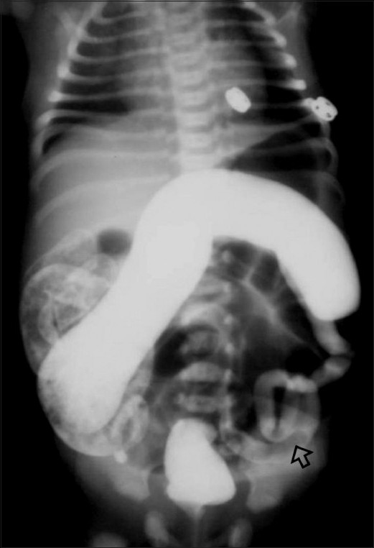

Slide 5
Hirschsprung’s Disease

Slide 6
Pathology
Functional intestinal obstruction resulting from the congenital absence of myenteric (Auerbach’s) plexus and the submucosal Meissner’s plexus

Slide 7
Types
Affects the rectum and sigmoid (70%)
Other cases affect long portion of colon and can with total colonic aganglionic in 8–10%

Slide 8
Clinical pictures
delayed passage of meconium for more than 24 hours is the cardinal symptom
Constipation
Marked abdominal distension
Vomiting
Picture of enterocolitis as diarrhoea. ( the commonest cause of death)

Slide 9
Radiological investigation
Barium enema
Requirement:
infant should not have rectal washouts or even digital examinations prior to barium enema, as it may distort the transitional zone appearance and give a false-negative diagnosis.

Slide 10
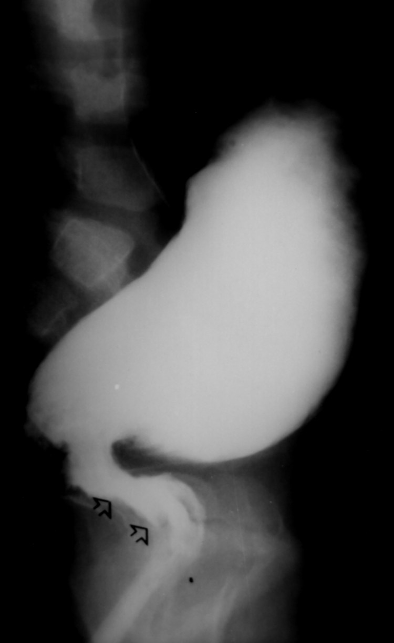
Radiological investigation
Barium enema
Finding
stenosed aganglionic segment,
Followed by funnel segment
(Transitional zone)
Then dilated bowel.

Slide 11
Instrumental investigation
Biopsy
The most used is suction biopsy:
Acetylcholinesterase (AChE) staining techniques show an increased activity in the parasympathetic nerves of the affected zone

Slide 12
Other investigation
Manometry
In normal people, distention of the rectum results in the reflex relaxation of the internal sphincter
This is absent in patients with Hirschsprung’s disease.

Slide 13
Treatment
Recently most of cases diagnosed in neonate
So now performing one-stage pull-through operations in the newborn with minimal morbidity
The advantages are
colonic dilatation can be quickly controlled by washouts
the calibre of the pull-through bowel is near normal, allowing for an accurate anastomosis

Slide 14
Treatment
Recently, one-stage pull-through with laparoscopic
techniques.
More recently, a transanal endorectal pull-through operation performed without opening the abdomen has been used with excellent results in rectosigmoid type

Slide 15
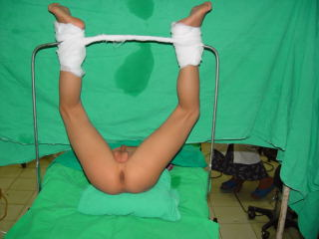

Slide 16
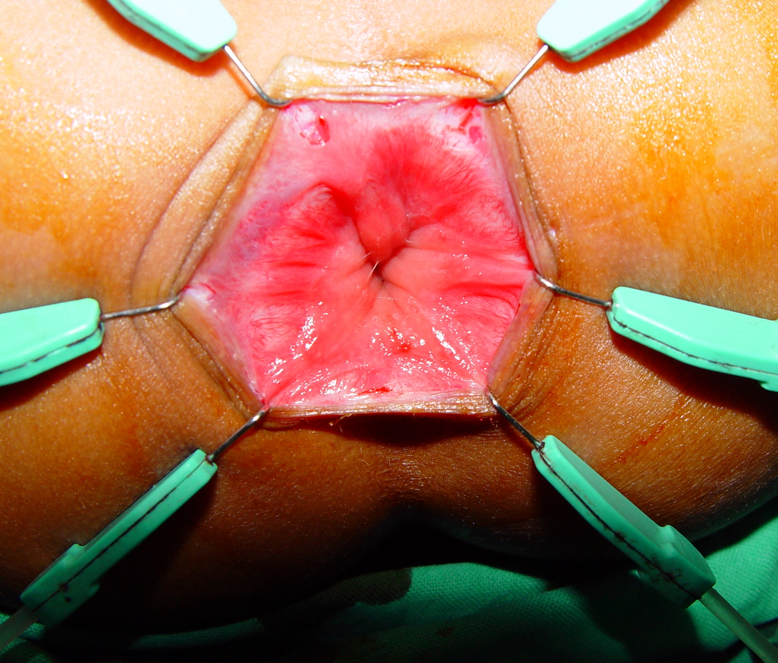
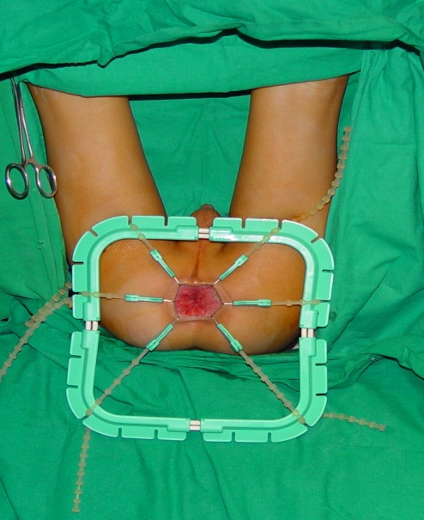

Slide 17
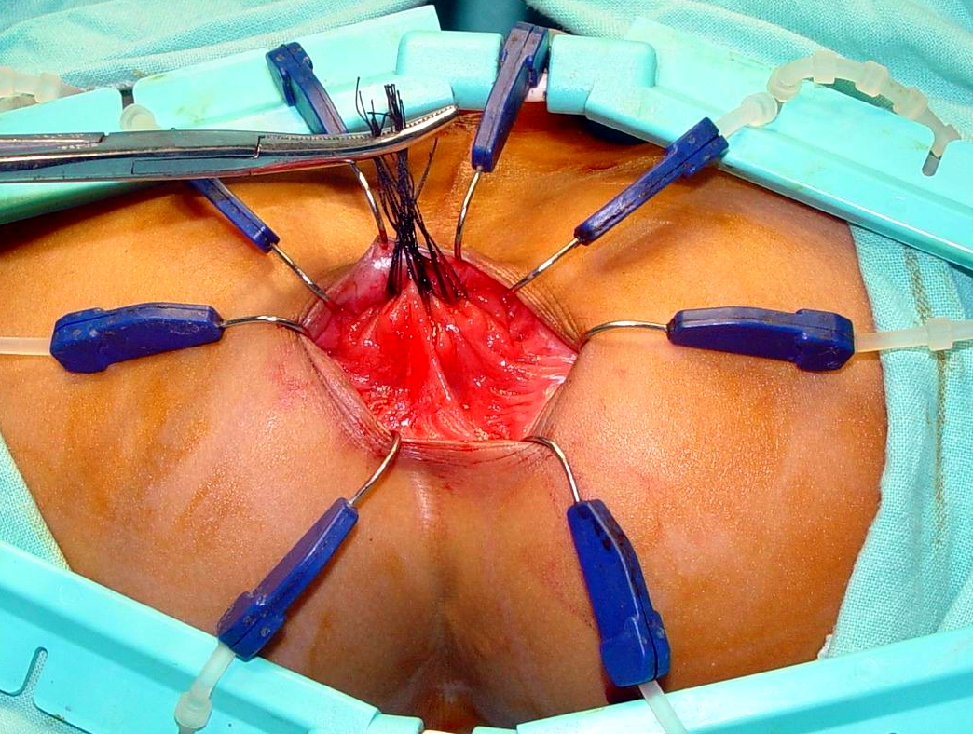

Slide 18
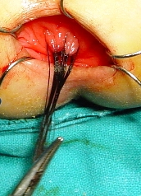
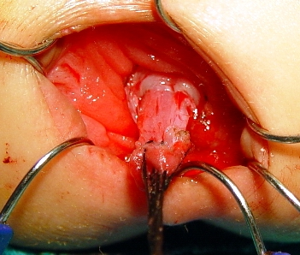
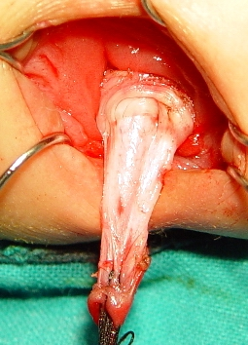

Slide 19
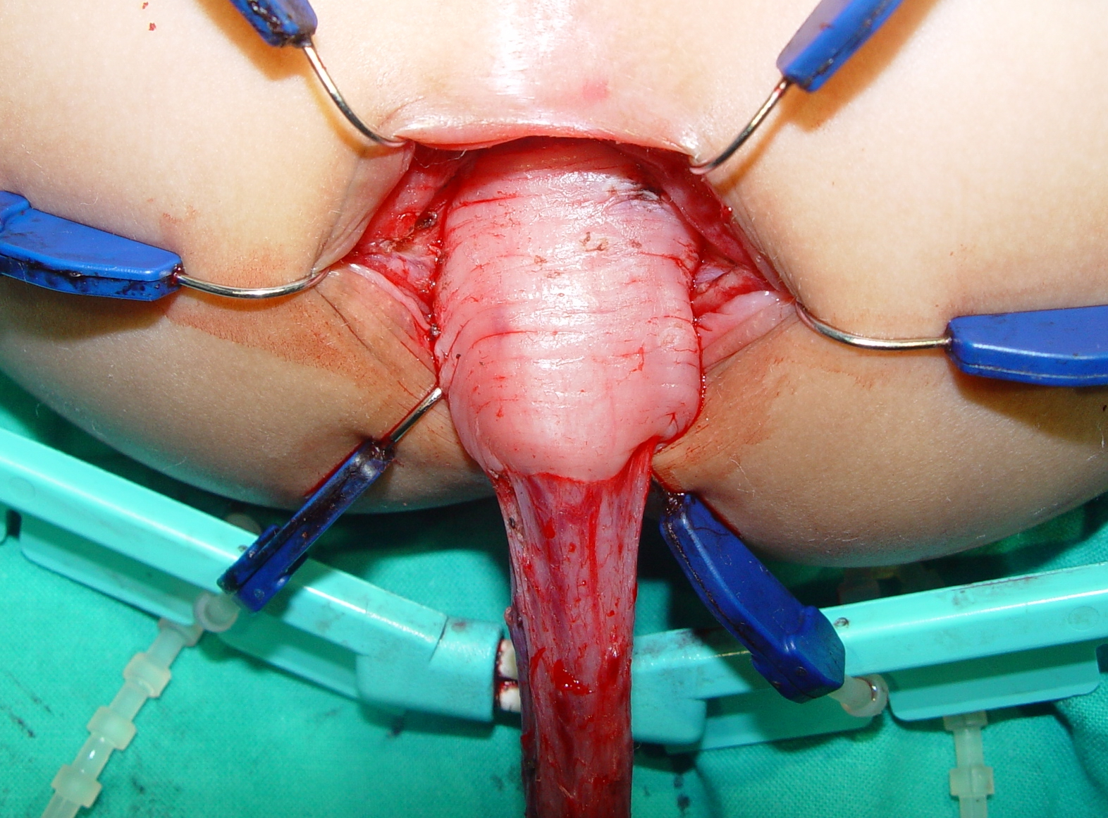

Slide 20
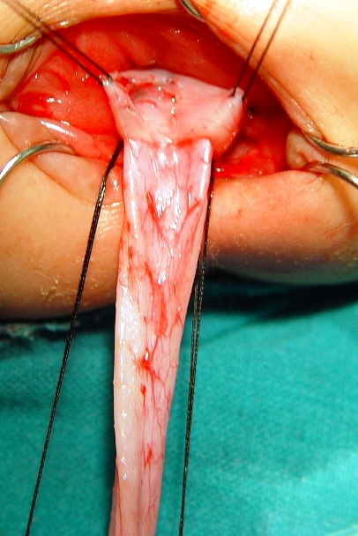
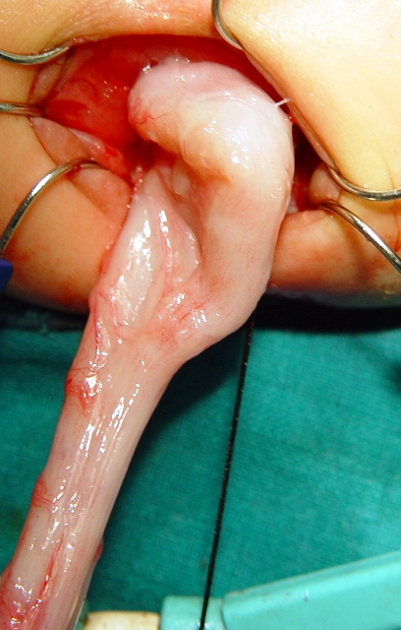
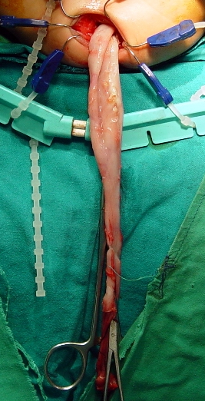

Slide 21
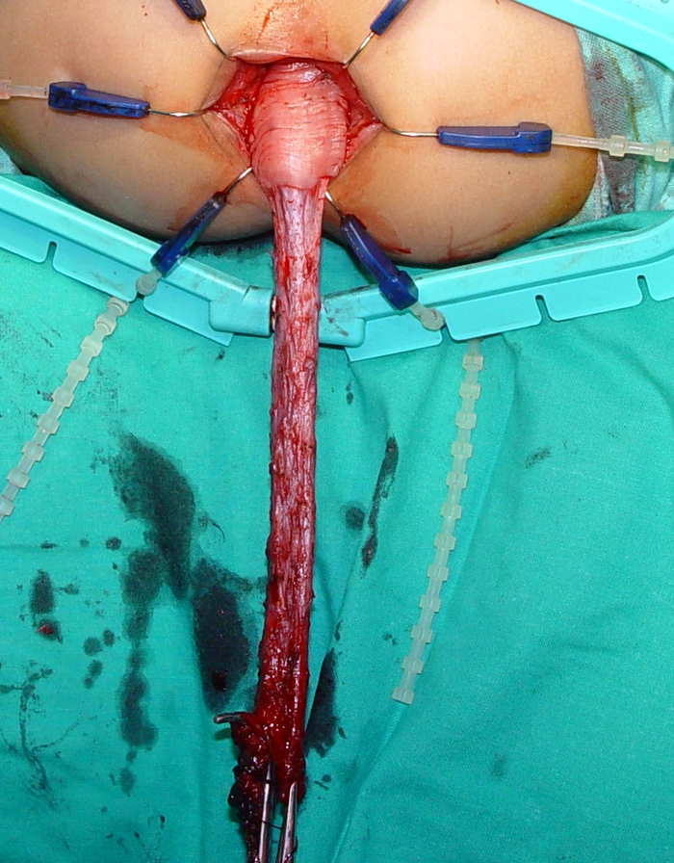
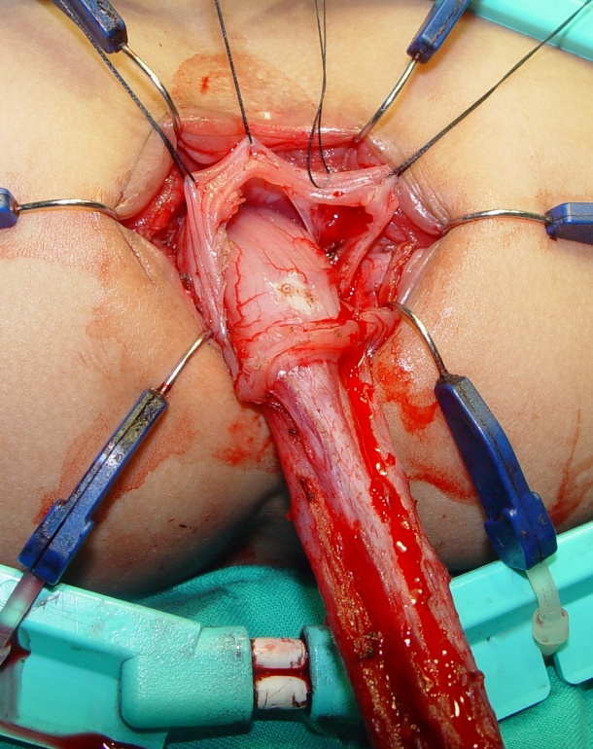
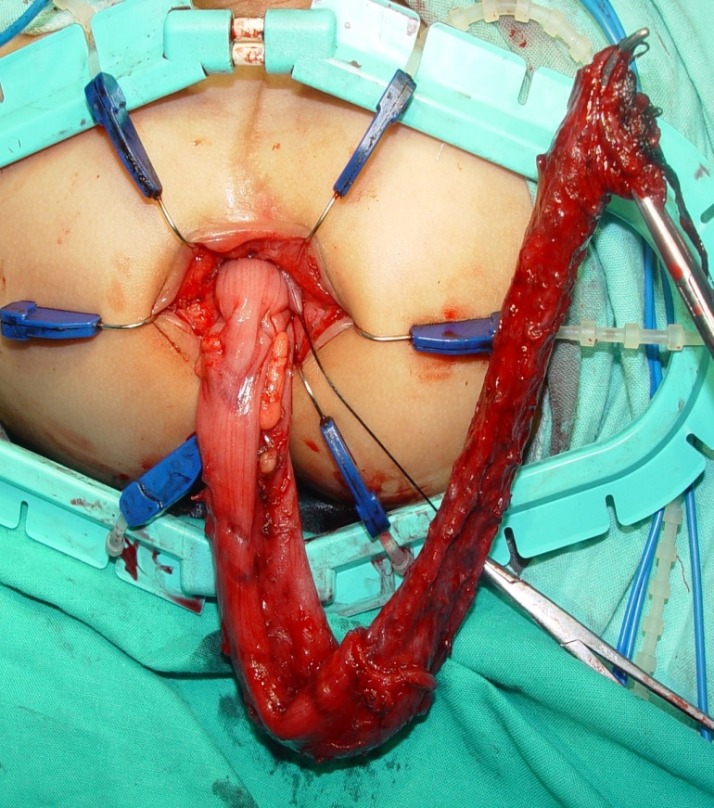

Slide 22
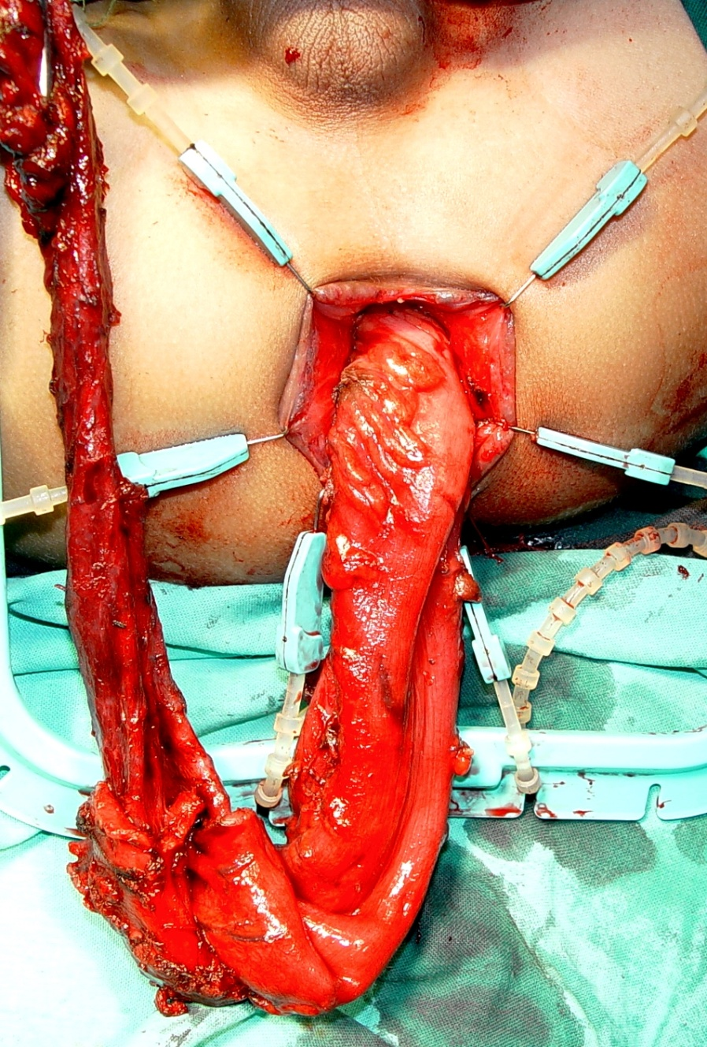


Slide 23
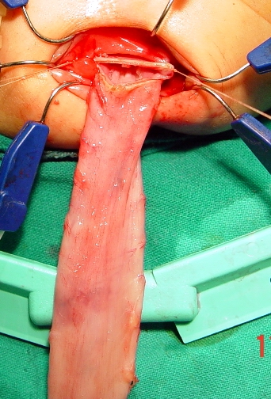
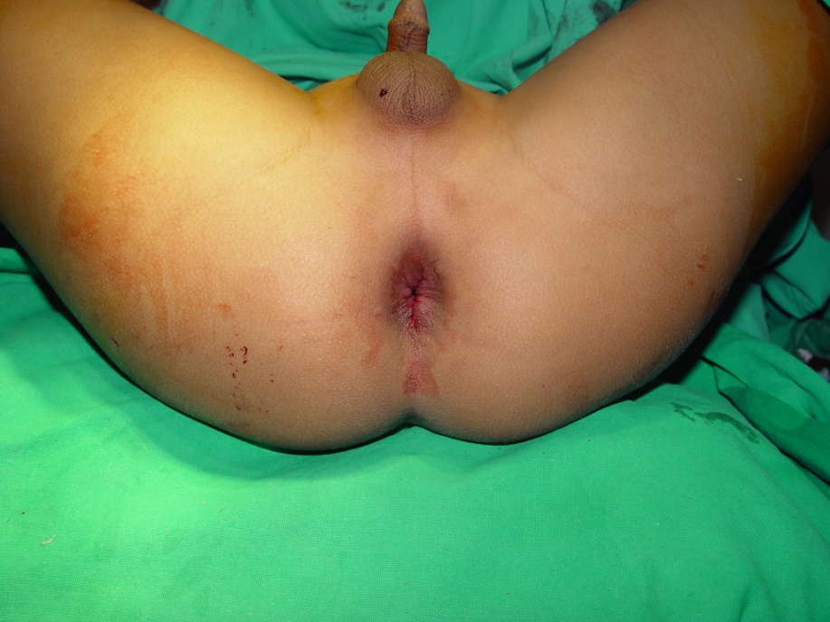

Slide 24
Operations
Swenson Procedure
Resection of the aganglionic segment deep into the pelvis and direct end to- end anastomosis of the proximal colon to the anorectal canal.
Duhamel Procedure
Aganglionic rectum is retained and the ganglionated bowel brought posteriorly and anastomosed to the aganglionic remnant in a side-to side

Slide 25
Operations
Soave Procedure
The Soave with its variations, is the most frequently performed procedure in the world
It involves an extramucosal resection of a retained
aganglionic rectal segment.
The rectal mucosa is removed and a muscular cuff retained.
The ganglionated colon is brought through this cuff and anastomosed to the dentate line in the rectum,
Its variant is laparscopic assisted and endorectal pull through

Slide 26
Anorectal Malformations

Slide 27
Incidence & associated anomalies
Incidence: 1 in 4,500
SEX: 60% male
Associated anomalies
VACTREL syndrome
Vertberal
Cardiac
Tracheal
Renal
Esophageal
Limb

Slide 28
Classifications
Old classification :
Low abnormalities
Termination of bowel below the pelvic floor
1)Covered anus
2)Ectopic anus
3)Stenosed anus
4)Membranous stenosis
High abnormalities
Termination of bowel above the pelvic floor

Slide 29
Recent classification
Female | Male
Perianal fistula | Perianal fistula | Anatomic type
Recto-vestibular fistula | Rectourethral fistula ( common) Bulblar Prostatic
Persistent cloaca < 3 cm common channel <3 cm common channel | Recto-vesical fistula(bladder – neck)
Imperforate anus without fistula | Imperforate anus without fistula
Rectal atresia | Rectal atresia
Rectal atresia | Complex type

Slide 30
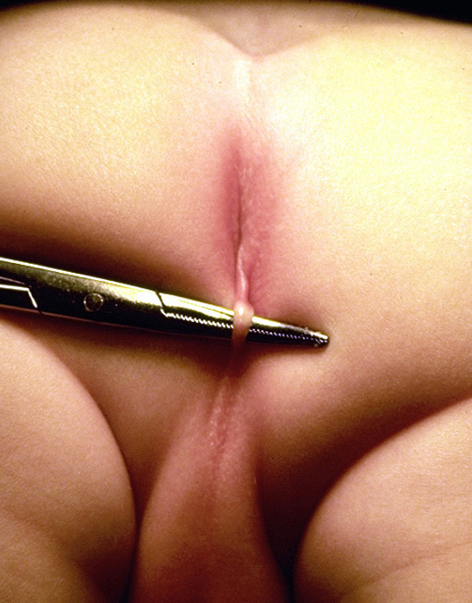
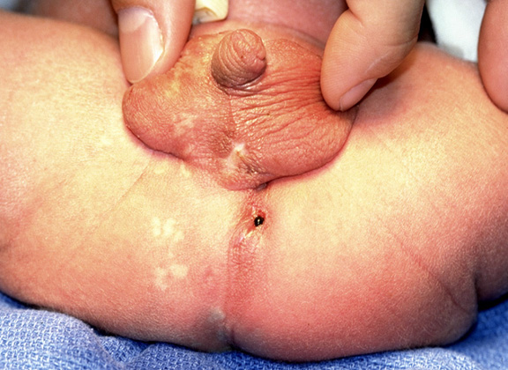
Perianal fistula in male
Bucket handle associated with fistula

Slide 31
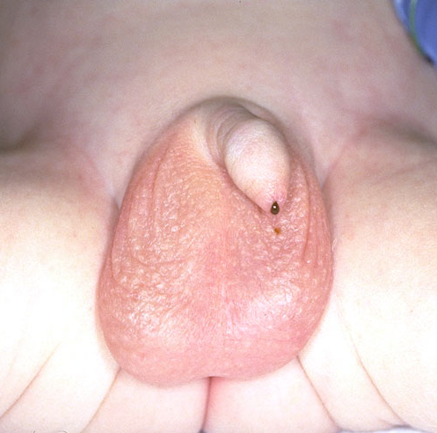

Slide 32
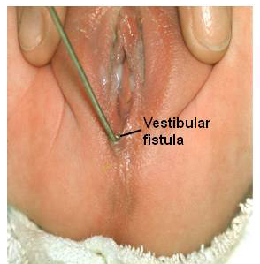

Slide 33
Clinical presentation
Failure to pass meconium within the 1st 24 hours of life.
Inspection
1. Presence of meconium .
If meconium is seen on the perineum perineal fistula.
If there is meconium in the urine  rectourinary fistula.
2. For presence of anal dimple
3. Development of muscle & sacrum

Slide 34
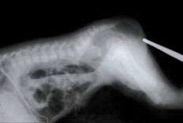
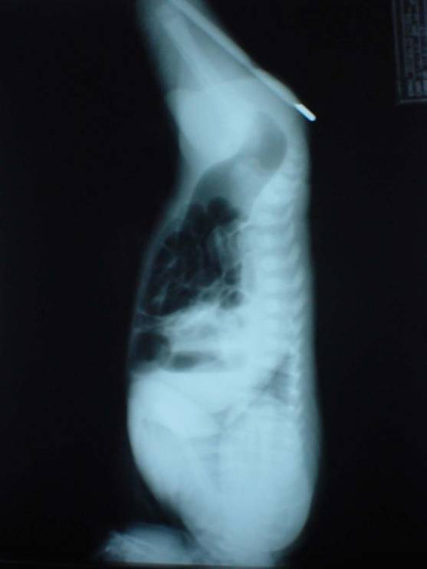
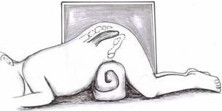
Investigations
Plain X ray : either invertogram or cross table lateral form done after 24 hours

Slide 35
Investigation
For evaluation of associated anomalies
Echocardiography
Kidney U/S

Slide 36
Treatment

Slide 37
Newborn male
Perineal inspection & evaluation of associated anomalies , then plain X ray
Rectal gas above coccyx
Associated defects
Abnormal Sacrum
Flat Bottom
Rectal gas below coccyx
No associated defects
Perineal Fistula
Anoplasty
Consider PSARP with or without colostomy
Colostomy

Slide 38
Newborn Female
Perineal inspection & evaluation of associated anomalies , then plain X ray
Perineal Fistula
Vestibular Fistula
No visible fistula
Single perineal orifice
( Cloaca )
Anoplasty or Dilatations
Colostomy or primary repair
Rectum above
coccyx
Rectum below
coccyx
Colostomy
Drain hydrocolpos
Urinary Diversion
(if necessary)
Colostomy or primary repair
Colostomy

Slide 39
Necrotizing enterocolitis

Slide 40
Incidence
It is a serious disease, that mainly affects premature babies under sever distress

Slide 41
Pathology & X ray
1. It is commonly affects ileum and Rt. colon
2. Ischemic mucosal change with invasion of wall by bacteria
3. Pneumatosis (air within intestinal wall) occurs  gangrene & perforation of the intestine

Slide 42
Treatment
Drain, patch & wait
Resects gangrenous bowel
Avoid massive resections
Exteriorize bowel

Slide 43

Thanks

